Slide 1
Unscramble a Blurry Image
--- predict a high-resolution image from a low-resolution input image
Group 12
Members: Fei Zheng, Guanren Wang, Xi Yang, Yiyao Hu

Slide 2
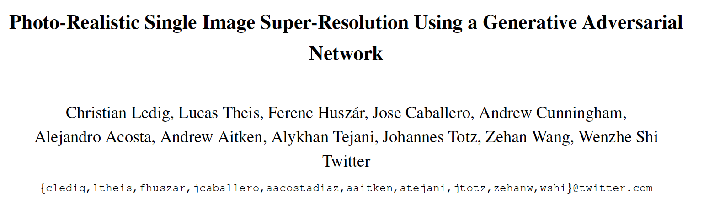
Two Models
1, Baseline Model --- GBM Tree
2, Advanced Model --- SRGAN

Slide 3
SRGAN
1, Input --- Randomly Selection & Down Sampling
2, Generator Network --- CNN & ResNet
3, Discriminator Network --- Classifier
4, Loss Function --- Content Loss + Adversarial Loss+ VGG loss
5, Pre-trained Generator Network

Slide 4

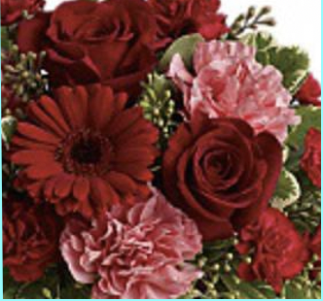
1, Input --- Randomly Selection & Down Sampling
Overcome the overfitting problem

Slide 5
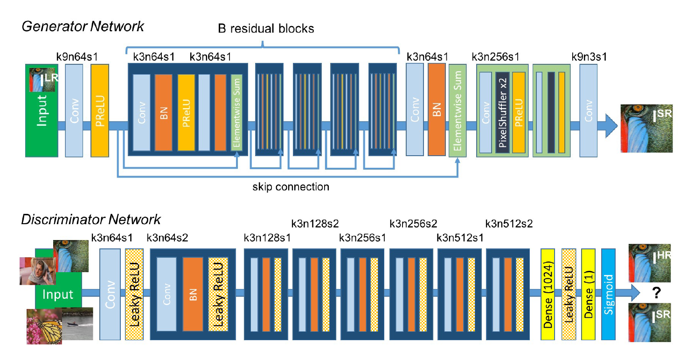
Architecture of Generator and Discriminator Network
“Photo-Realistic Single Image Super-Resolution Using a Generative Adversarial Network”

Slide 6
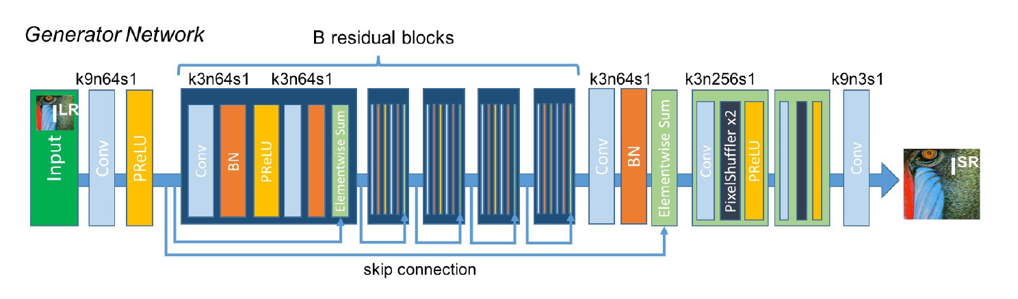
2, Generator Network --- CNN & ResNet
“Photo-Realistic Single Image Super-Resolution Using a Generative Adversarial Network”
Gradient Vanishing
Accelerating the Computing Process

Slide 7
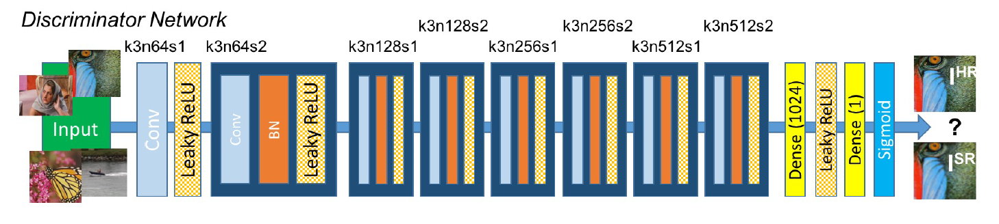
3, Discriminator Network --- Classifier
Classifier
“Photo-Realistic Single Image Super-Resolution Using a Generative Adversarial Network”
GAN (Generative Adversarial Networks)
GANs provide a powerful framework for generating plausible-looking natural images with high perceptual quality.

Slide 8
4, Loss Function
Loss Function = Content Loss (Loss of Generator)
+ Adversarial Loss (Loss of Discriminator)
+ VGG loss (Loss of pre-trained 19 layer VGG network
described in Simonyan and Zisserman)
--- More Invariant to Changes in Pixel Space

Slide 9
5, Pre-Trained Generator Network
Generator Network (CNN & ResNet)
& MSE Content Loss Function
Pre-Trained Model
Stronger Generator
Initialization of SRGAN
Speed up the Process

Slide 10
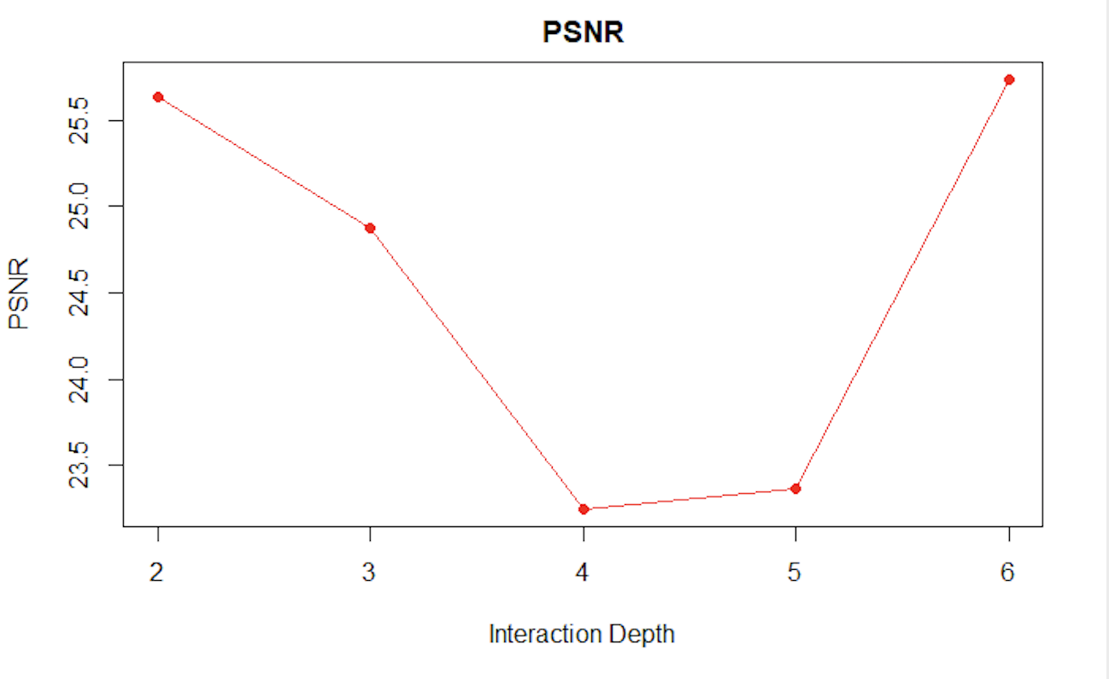
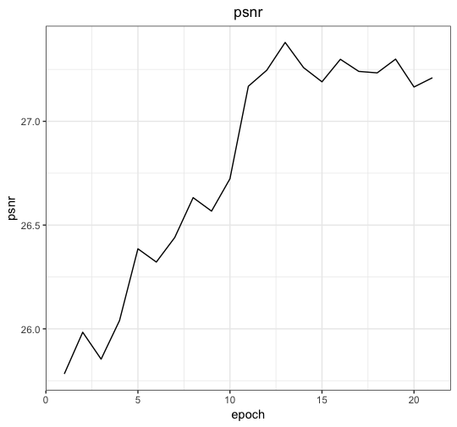
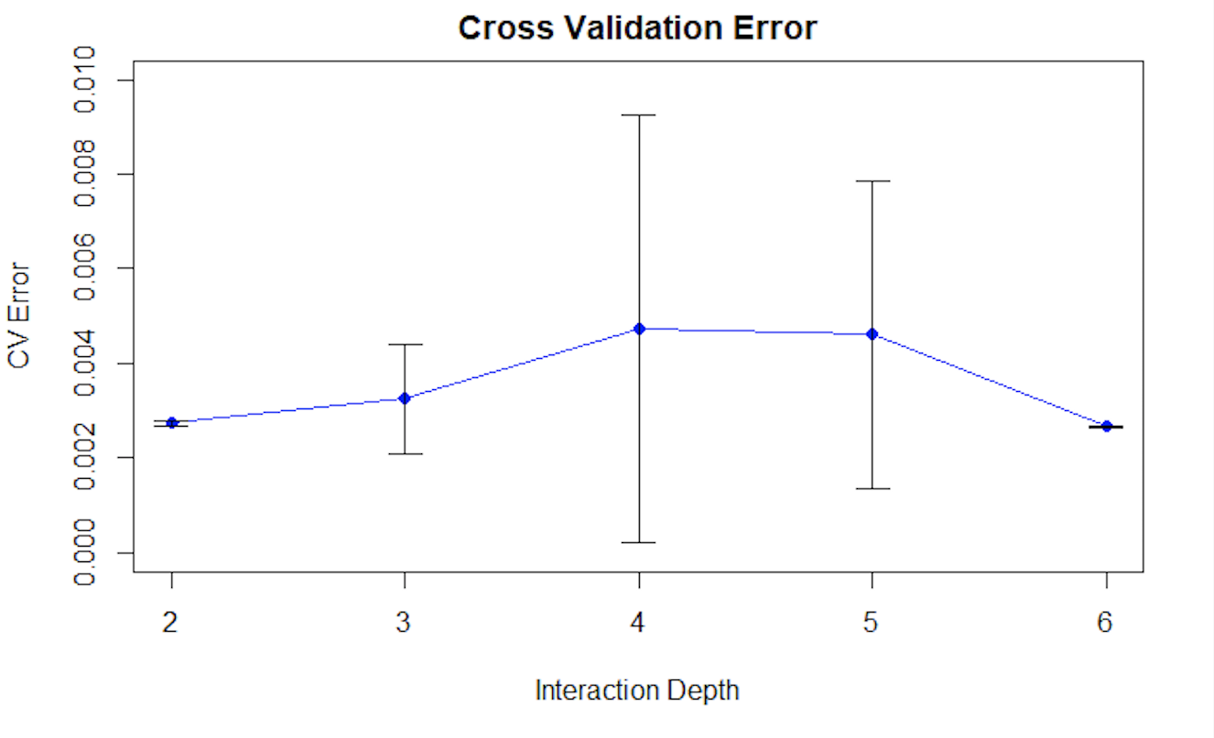
Average psnr
Baseline
SRGAN

Slide 11
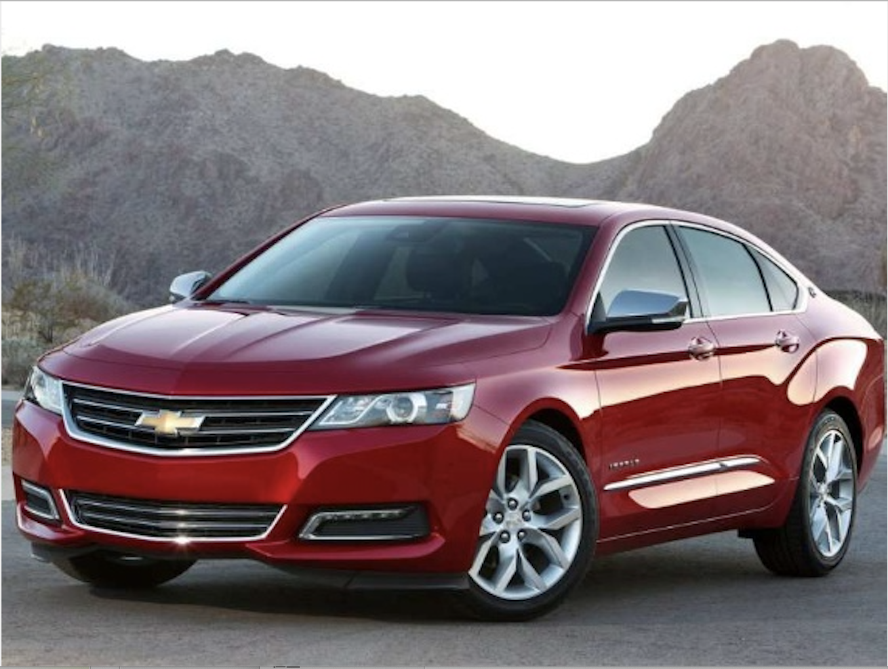

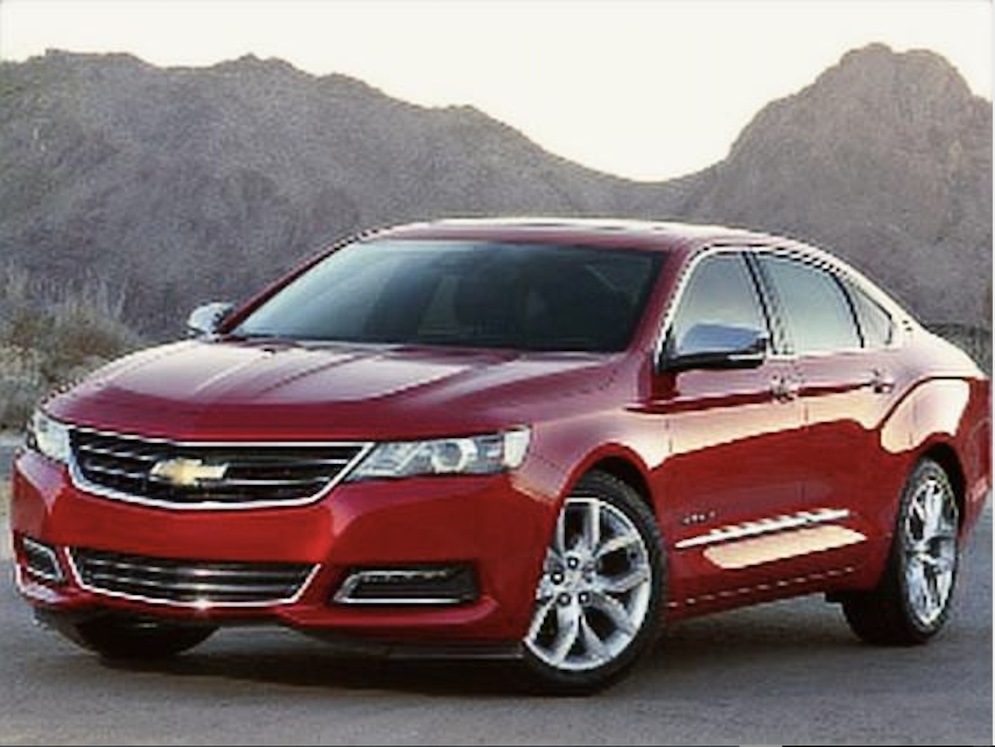

Baseline
Psnr:
27.85071
True Image
Initialization
Psnr:
30.9051
SRGAN
Psnr:
31.6984

Slide 12
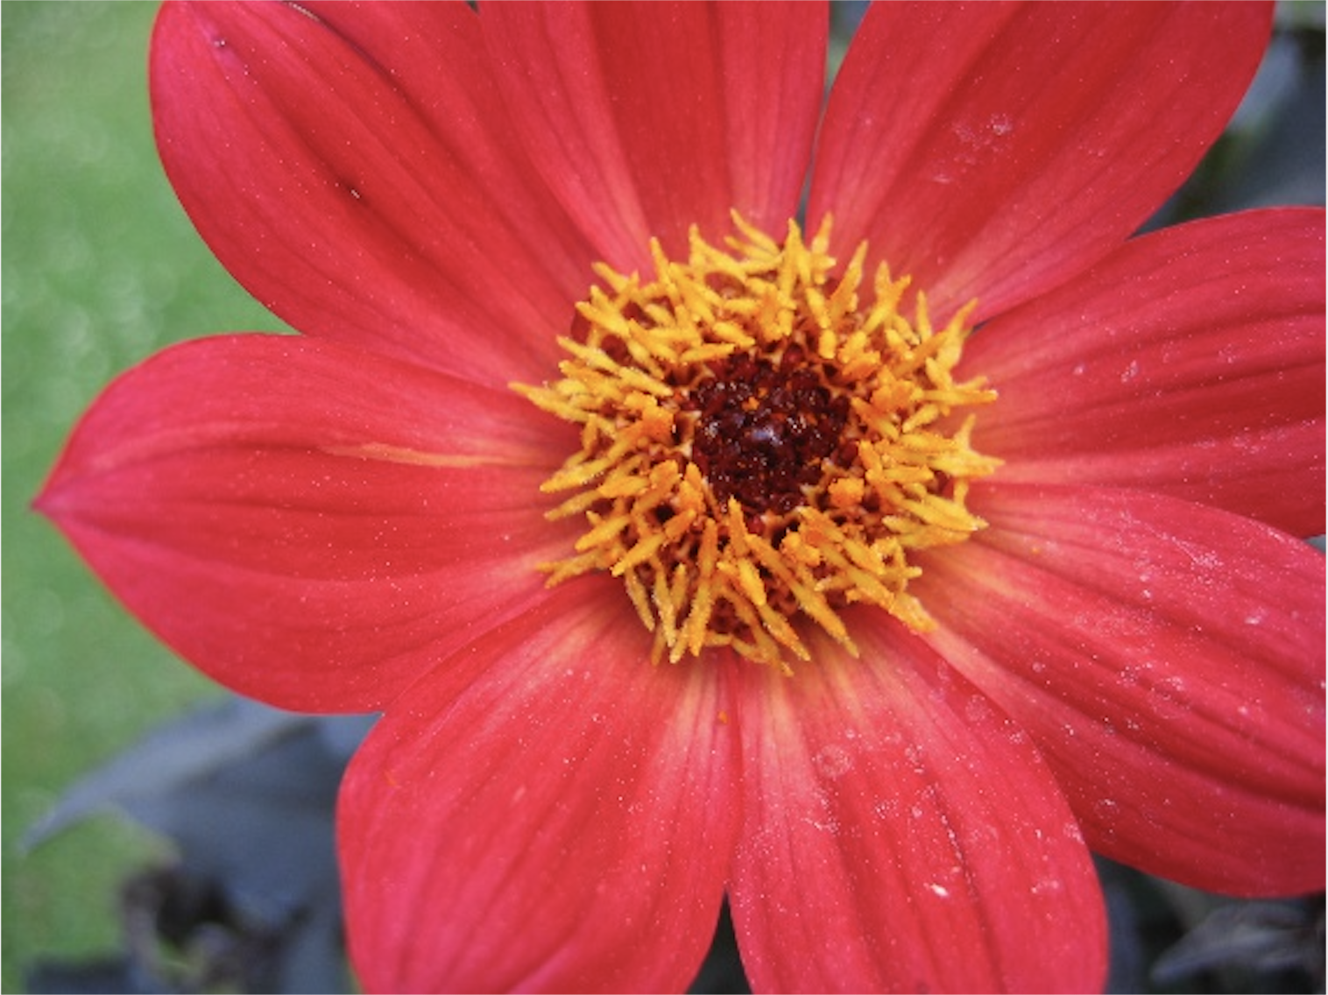
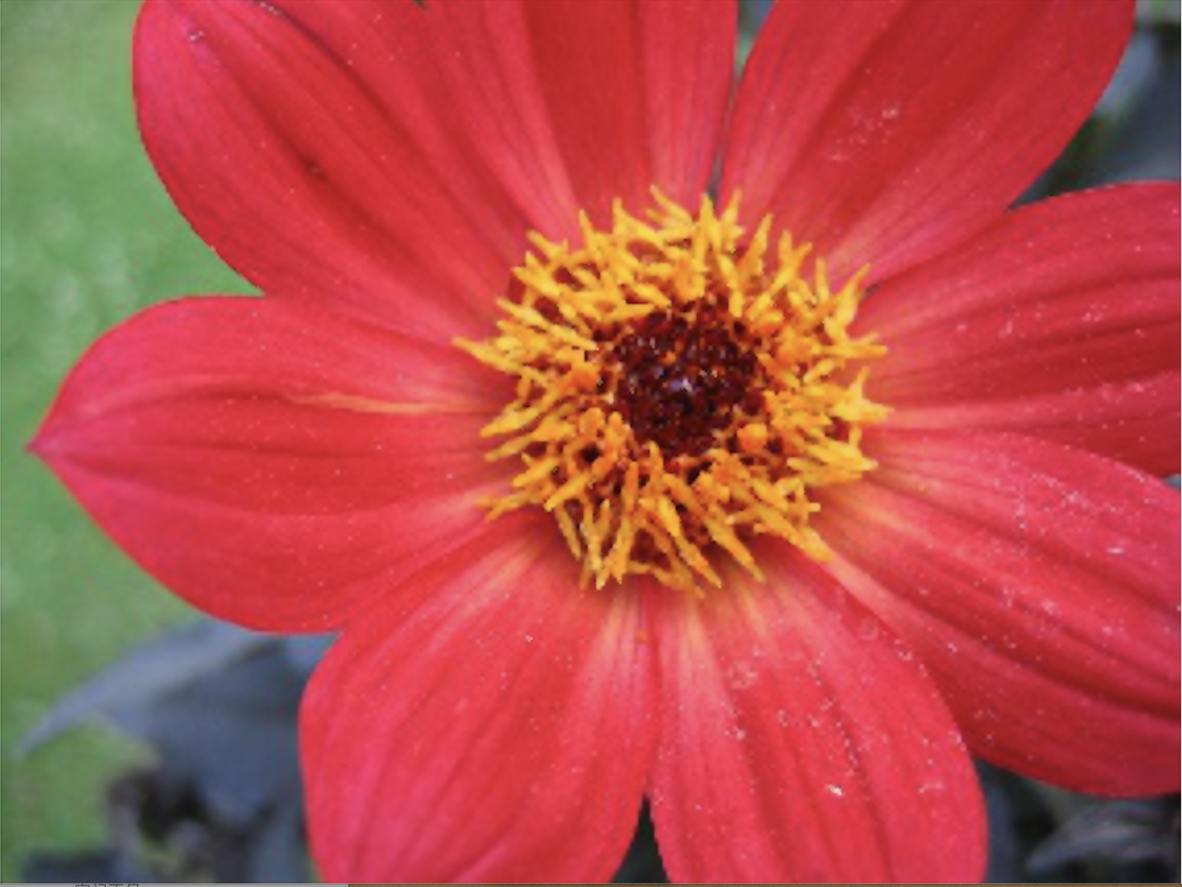
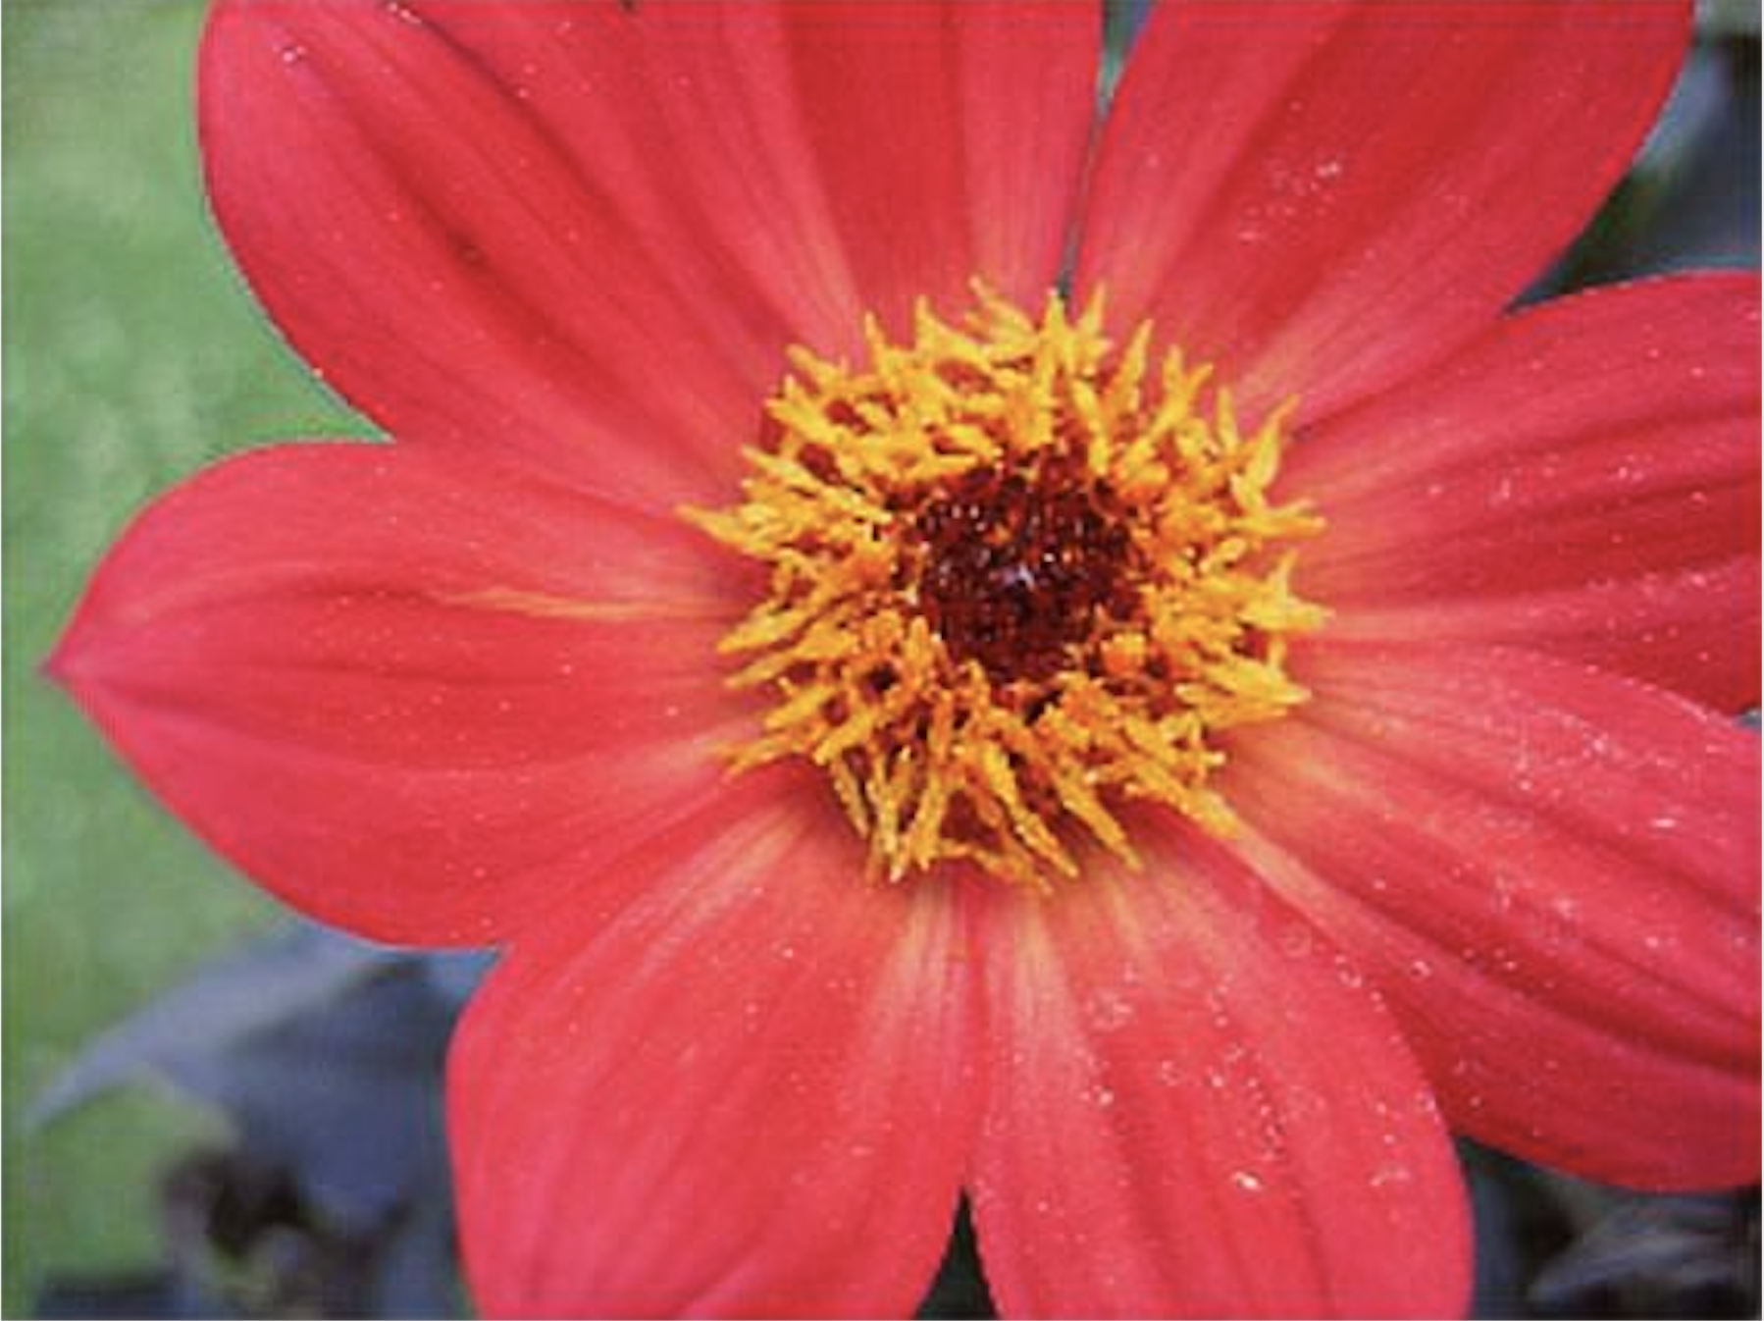

Baseline
Psnr:
31.10396
True Image
Initialization
Psnr:
29.7417
SRGAN
Psnr:
32.3910

Slide 13
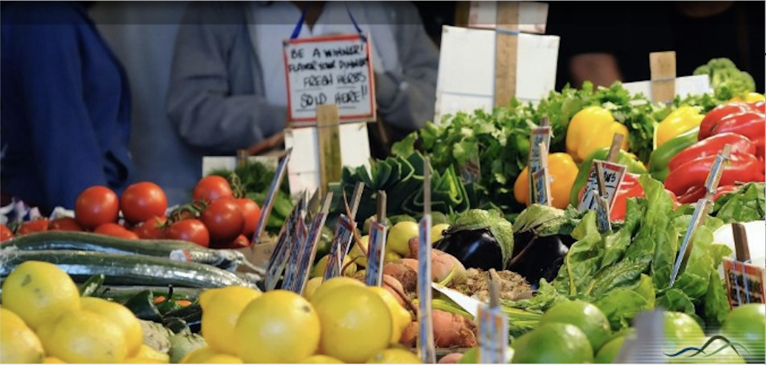

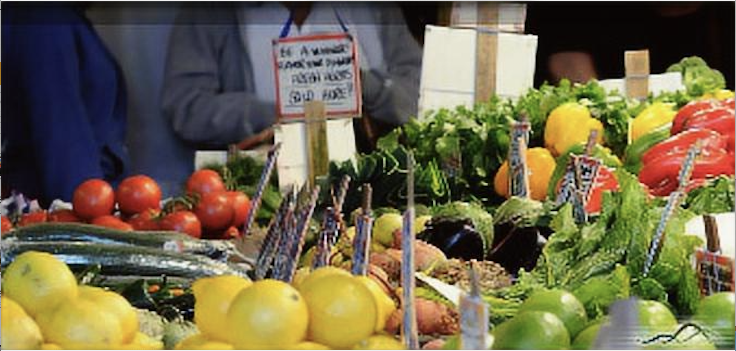

True Image
Baseline psnr:28.04039
Initialization psnr: 30.5383
SRGAN psnr:30.9866

Slide 14
Thanks!
Group 12
Members: Fei Zheng, Guanren Wang, Xi Yang, Yiyao Hu

